Slide 1
Customer Review Machine Learning Model
British Airways

Slide 2
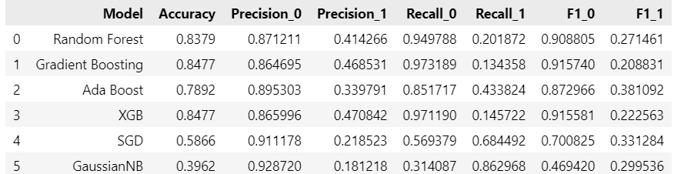
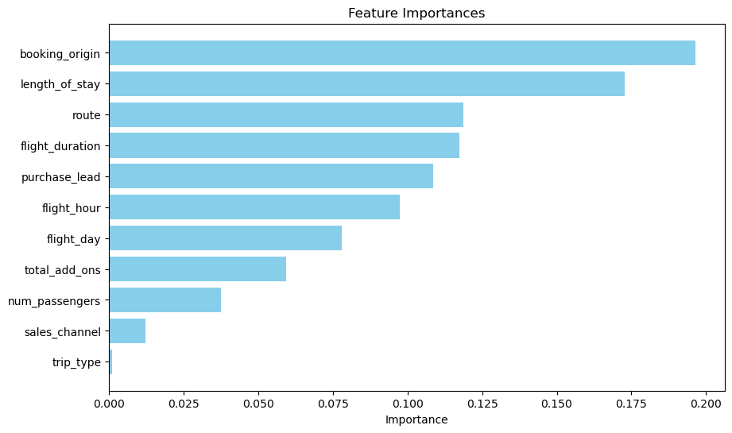
Feature Importance & Performance:

